Slide 1
Data Wrangling in R
Session 3
Amrom Obstfeld
Introduction to R Workshop
May 6, 2019

Slide 2
July 16 2020 | Session | Instructor
1:00 pm - 1:30 pm | Instructor Introductions, Introduction to technology | Amrom Obstfeld
1:30 pm - 2:15 pm | Introduction to R and RStudio | Joe Rudolf
2:30 pm - 3:15 pm | R basics for Reproducible Reporting | Patrick Mathias
3:30 pm - 5:00 pm | Data Visualization in R | Stephan Kadauke
July 17 2020
1:00 pm - 2:30 pm | Data Transformation | Amrom Obstfeld
2:45 pm - 4:15 pm | Statistical Analysis in R | Dan Herman
4:30 pm - 5:00 pm | Advanced Reporting in R | Patrick Mathias

Slide 3
Goals and Objectives
Learn how to:
Select and filter data of interest from a large dataset
Create new columns from raw data

Slide 5


What is a “Tidy” Data Frame
A data set is tidy if:
Each variable is in its own column
Each observation is in its own row
Each value is in its own cell

Slide 6

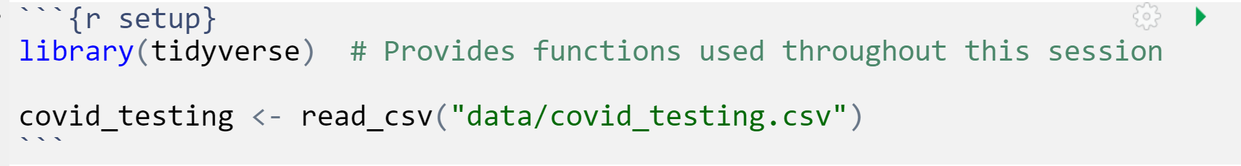
Your Turn 1
Open "04-Transform.Rmd" Run the setup chunk
Notes:
Raise your hand when you have finished this step

Slide 7
Your Turn 1
How can you confirm that you have successfully loaded the data file into Rstudio?
1. The code that imported the data did not yield an error
2. Code that references `covid_testing` object runs without errors
3. The `covid_testing` object is present in the environment pane
4. All of the above

Slide 8
Your Turn 1
How can you confirm that you have successfully loaded the data file into Rstudio?
1. The code that imported the data did not yield an error
2. Code that references `covid_testing` object runs without errors
3. The `covid_testing` object is present in the environment pane
4. All of the above

Slide 9

dplyr

Slide 10

Transform Data with
Notes:
After collecting and loading data, almost all datasets need to be cleaned in some way. The dplyr package provides functions to carve, expand, and collapse a data frame that will cover 95% of use cases.

Slide 11
dplyr
dplyr implements a grammar for transforming tabular data.
Notes:
Getting your data into this format requires some upfront work, but that work pays off in the long term. Once you have tidy data and the tidy tools provided by packages in the tidyverse, you will spend much less time munging data from one representation to another, allowing you to spend more time on the analytic questions at hand. The dplyr package provides functions that begin this process, they help you carve, expand, and collapse data.

Slide 12
dplyr: a grammar for transforming data
1
Extract existing variables.
select()
2
Extract existing rows.
filter()
3
Derive new variables.
mutate()
4
summarize()
Change the unit of analysis.
Notes:
What do I mean by a grammar for transforming data.
Dplyr facilitates data manipulation by providing a set of verbs that operate on data using a consistent syntax and that solve the most common data manipulation challenges that we face in data analysis in general and in clinical data science more specifically.

Slide 13
common syntax
Each function takes a data frame as its first argument and returns a data frame as its output.
filter(data, ...)
dplyr function
data frame to transform
specific arguments
Notes:
One of the major advantages of using dplyr functions in your data analysis is that dplyr functions all use a common syntax, which makes them easier to learn.
Each one will take a data frame as the first argument, and there will then be other arguments that basically serve as instructions to the function on how to operate on the data frame.
And by arguments I mean options that we can set within the function that will determine how that function will work

Slide 14
Isolating data
Notes:
The first set of functions we will explore will be ones whose primary goal is to isolate the data of interest from a large pile of other data.

Slide 15
Isolating data
Extract columns with select().
Extract rows with filter().
Arrange rows, with arrange().
Notes:
We will start with three functions that are handy ways to find the data you’re interested in the large laboratory datasets regularly dumped on you. Reducing a data set to a subset of columns and/or rows are common operations in data analysis, particularly on the path to answering a specific set of questions about a data set.

Slide 16

select()
Notes:
We will start slowly, with the select function. It’s not uncommon to get datasets with hundreds or even thousands of variables. In this case, the first challenge is often narrowing in on the variables you’re actually interested in. select() allows you to rapidly zoom in on a useful subset using operations based on the names of the variables.

Slide 17
select()
Extract columns from a data frame
Notes:
Select does one thing but does it well. It extracts columns of your choosing from a data frame and returns these columns as a new data frame. In the output, you will wind up with your columns of interest and all the rows that you started with.

Slide 18
select()
Extract columns from a data frame
select(data,... )
data frame to transform
name(s) of columns to extract
(or a select helper) function)
dplyr function
data frame to transform
Notes:
Select takes the starting data frame as its first argument, "data".
After that it takes any number of additional arguments that specify the columns that you want to pick. In it’s simplest form, those additional arguments will just be the names of the columns that you want to select. However, in very wide datasets, writing out the names of the columns you want can sometimes be laborious. It doesn’t scale well. That’s why the developers of the dplyr function have added several convenience functions that can more succinctly identify the columns you want. We’ll cover that after the next exercise.

Slide 19
select()
Extract columns by name.
select(data,... )
select(orders, description, department)
data frame to transform
name(s) of columns to extract
(or a select helper) function)
data frame to transform
Notes:
Let’s take a look at the orders data frame that we loaded earlier in the lesson, for example.
The select statement will take the data frame ‘orders’, and return a new data frame that only has the columns description and department. You could list as many or as few column names as you want in the select function, it will bring back everything you list.

Slide 20
select()
Extract columns by name.
select(orders, description, department)
orders
description | department
PROTHROMBIN TIME | INTERNAL MEDICINE CLINIC
BASIC METABOLIC PANEL | INTERNAL MEDICINE CLINIC
THYROID STIMULATING HORMONE | ENDOCRINOLOGY CLINIC
T4, FREE | ENDOCRINOLOGY CLINIC
order_id | patient_id | description | proc_code | department
19766 | 511388 | PROTHROMBIN TIME | PRO | INTERNAL MEDICINE CLINIC
88444 | 511388 | BASIC METABOLIC PANEL | BMP | INTERNAL MEDICINE CLINIC
40477 | 508061 | THYROID STIMULATING HORMONE | TSH | ENDOCRINOLOGY CLINIC
97641 | 508061 | T4, FREE | T4FR | ENDOCRINOLOGY CLINIC
description | department
PROTHROMBIN TIME | INTERNAL MEDICINE CLINIC
BASIC METABOLIC PANEL | INTERNAL MEDICINE CLINIC
THYROID STIMULATING HORMONE | ENDOCRINOLOGY CLINIC
T4, FREE | ENDOCRINOLOGY CLINIC
Notes:
So, if you were to use the code above, the orders data frame would be accepted as input and a subset of it, the Description and the Department columns would be returned as output

Slide 21
select()
c() is a little function in R that combines two or more values into a vector
Extract columns by index.
select(orders, c(1,4))
orders
description | department
PROTHROMBIN TIME | INTERNAL MEDICINE CLINIC
BASIC METABOLIC PANEL | INTERNAL MEDICINE CLINIC
THYROID STIMULATING HORMONE | ENDOCRINOLOGY CLINIC
T4, FREE | ENDOCRINOLOGY CLINIC
order_id | patient_id | description | proc_code | department
19766 | 511388 | PROTHROMBIN TIME | PRO | INTERNAL MEDICINE CLINIC
88444 | 511388 | BASIC METABOLIC PANEL | BMP | INTERNAL MEDICINE CLINIC
40477 | 508061 | THYROID STIMULATING HORMONE | TSH | ENDOCRINOLOGY CLINIC
97641 | 508061 | T4, FREE | T4FR | ENDOCRINOLOGY CLINIC
order_id | proc_code
19766 | PRO
88444 | BMP
40477 | TSH
97641 | T4FR
Notes:
Select is very flexible in terms of the ways that you can specify the columns you do or don’t want in the output. Here I’m showing you that I can give a numeric index of the columns that I want, in this cases the first and the fourth, and select dutifully provides these in the output. Note that when listing out these indexes one should put them in the ‘c’ (which stands for combine) function.

Slide 22
Your Turn 2
Alter the code to select just the order_status_c column using (1) column name and (2) column number
Assign the output to a new object "orders_2"
orders_2 <- select(orders, ____________)

Slide 23
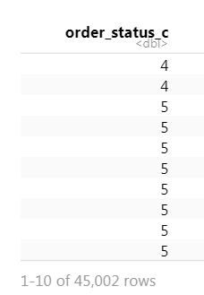
select(orders, order_status_c)
select(orders, 8)

Slide 24
select() helpers
: Select range of columns
select(orders, order_id:lab_status_c)
– Select every column but
select(orders, -c(description, order_status_c))
starts_with() Select columns that start with…
select(orders, starts_with("order"))
ends_with() Select columns that end with…
select(orders, ends_with(“descr"))
Notes:
Select provides many convenient ways to specify which columns you want. For instance, you can put the name of two columns separated by a colon mark, and select will return those two columns and all those in between. With select you could put a negative sign in front of a column name or a vector of column names and you'll get back everything except those columns. Then there's other functions that you can use inside of select that provide even more flexibility around defining which columns you want. For instance, you can use special function like starts_with and ends_with to instruct select on which columns you want based on a string.

Slide 25
select() helpers
contains() Select columns whose names contain…
select(orders, contains("time"))
matches() Select columns whose names match regular expression
select(orders, matches("^.{4}$"))
Notes:
Listed here are additional select helper functions. You can see they allow you to pull out columns whose names have a certain string in them or that match a certain regular expression. If you have a very large data set with many columns selecting variables out of it might be an important task and these functions might make it easier for you to identify desired columns in a more automated fashion.

Slide 26
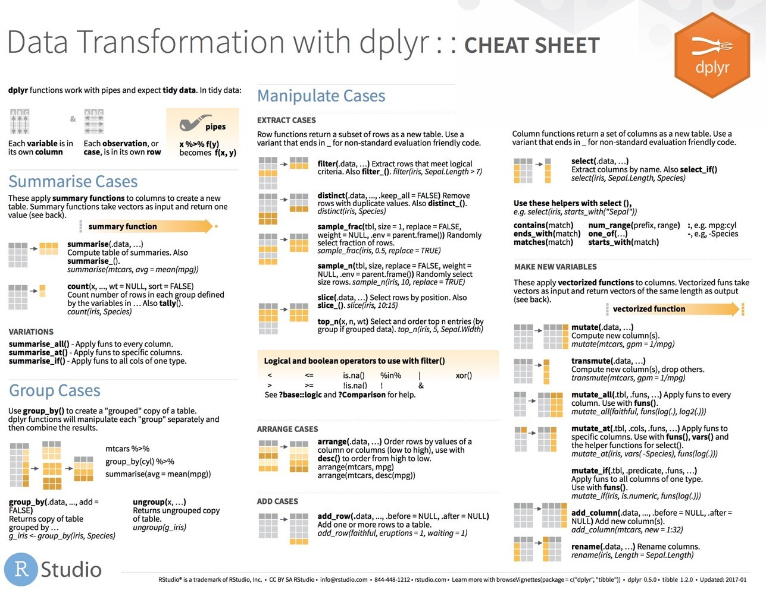
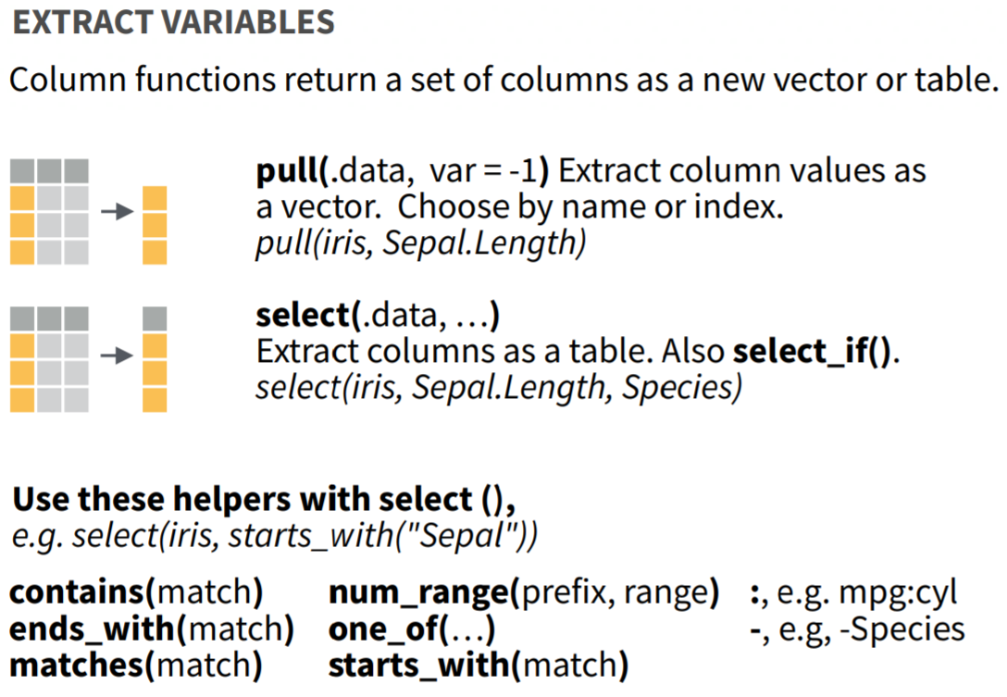
select() helpers
Notes:
I’ve only listed for you a selection of the available ways you can use helpers with select() to pull out the columns you need for your analysis. For a more complete list, see the select() section on the dplyr cheatsheet,

Slide 27
Consider 1
Which of these is NOT a way to remove the columns that represent status codes
(i.e. codes for lab status, order status, and cancelation)?
select(orders, -ends_with("_c"))
select(orders, -c(lab_status_c, order_status_c, reason_for_canc_c))
select(orders, -c(6,8,10))
select(orders, -contains("status"))
Notes:
Hint: Review the columns in the dataset by clicking on the arrow next to the orders data set in the environment tab in the upper right pane of Rstudio

Slide 28
Consider 1
Which of these is NOT a way to remove the columns that represent status codes
(i.e. codes for lab status, order status, and cancelation)?
select(orders, -ends_with("_c"))
select(orders, -c(lab_status_c, order_status_c, reason_for_canc_c))
select(orders, -c(6,8,10))
select(orders, -contains("status"))

Slide 29
select() also helpful for renaming
select(orders,
desc = description,
dept = department)
description | department
PROTHROMBIN TIME | INTERNAL MEDICINE CLINIC
BASIC METABOLIC PANEL | INTERNAL MEDICINE CLINIC
THYROID STIMULATING HORMONE | ENDOCRINOLOGY CLINIC
T4, FREE | ENDOCRINOLOGY CLINIC
orders
order_id | patient_id | description | proc_code | department
19766 | 511388 | PROTHROMBIN TIME | PRO | INTERNAL MEDICINE CLINIC
88444 | 511388 | BASIC METABOLIC PANEL | BMP | INTERNAL MEDICINE CLINIC
40477 | 508061 | THYROID STIMULATING HORMONE | TSH | ENDOCRINOLOGY CLINIC
97641 | 508061 | T4, FREE | T4FR | ENDOCRINOLOGY CLINIC
desc | dept
PROTHROMBIN TIME | INTERNAL MEDICINE CLINIC
BASIC METABOLIC PANEL | INTERNAL MEDICINE CLINIC
THYROID STIMULATING HORMONE | ENDOCRINOLOGY CLINIC
T4, FREE | ENDOCRINOLOGY CLINIC
Notes:
select() is also handy when it comes to changing the names of your columns. Column names are inevitably terrible when you first receive your data as its often coming from a database or instrument. select() provides a quick way to do the renaming at the same time that you’re identifying your columns of interest.

Slide 30
rename()
rename(orders,
desc = description,
dept = department)
orders
order_id | patient_id | description | proc_code | department
19766 | 511388 | PROTHROMBIN TIME | PRO | INTERNAL MEDICINE CLINIC
88444 | 511388 | BASIC METABOLIC PANEL | BMP | INTERNAL MEDICINE CLINIC
40477 | 508061 | THYROID STIMULATING HORMONE | TSH | ENDOCRINOLOGY CLINIC
97641 | 508061 | T4, FREE | T4FR | ENDOCRINOLOGY CLINIC
description | department
PROTHROMBIN TIME | INTERNAL MEDICINE CLINIC
BASIC METABOLIC PANEL | INTERNAL MEDICINE CLINIC
THYROID STIMULATING HORMONE | ENDOCRINOLOGY CLINIC
T4, FREE | ENDOCRINOLOGY CLINIC
order_id | patient_id | desc | proc_code | dept
19766 | 511388 | PROTHROMBIN TIME | PRO | INTERNAL MEDICINE CLINIC
88444 | 511388 | BASIC METABOLIC PANEL | BMP | INTERNAL MEDICINE CLINIC
40477 | 508061 | THYROID STIMULATING HORMONE | TSH | ENDOCRINOLOGY CLINIC
97641 | 508061 | T4, FREE | T4FR | ENDOCRINOLOGY CLINIC
Notes:
R has many ways to rename columns because of how important it is. You can also use a dedicated dplyr function, rename() to accomplish this as well. Note that as opposed to select(), when using rename(), all the columns are retaimed in the output of the function.

Slide 31
filter()
Notes:
Now let's carve the data set in the other direction. If you need only a subset of rows from your data set, `filter()` allows you to pick rows (cases) based on values, ie. you can subset your data based on logic.

Slide 32
filter()
Extract rows that meet logical criteria.

Slide 33
filter()
Extract rows that meet logical criteria.
filter(data,... )
one or more logical tests (filter returns each row for which the test is TRUE)
data frame to transform
Notes:
The syntax for filter is very similar to what we used for select. The first argument is a data frame from which we will be selecting rows. Afterwards we can input one more logical tests. R then performs that logical test on each row of the dataset and returns all rows in which the logical test was TRUE. Rows for which the tests are TRUE are returned in the output as a data frame.

Slide 34
filter()
Extract rows that meet logical criteria.
filter(orders, patient_id==508061)
order_id | patient_id | description | proc_code
19766 | 511388 | PROTHROMBIN TIME | PRO
88444 | 511388 | BASIC METABOLIC PANEL | BMP
40477 | 508061 | THYROID STIMULATING HORMONE | TSH
97641 | 508061 | T4, FREE | T4FR
order_id | patient_id | description | proc_code
40477 | 508061 | THYROID STIMULATING HORMONE | TSH
97641 | 508061 | T4, FREE | T4FR
data frame to transform
Notes:
Here we supply the orders data frame as the first argument. Afterwards we provide one logical test; we ask filter() to return rows in which the patient_id is 508061.

Slide 35
filter()
Extract rows that meet logical criteria.
filter(orders, patient_id == 508061)
order_id | patient_id | description | proc_code
19766 | 511388 | PROTHROMBIN TIME | PRO
88444 | 511388 | BASIC METABOLIC PANEL | BMP
40477 | 508061 | THYROID STIMULATING HORMONE | TSH
97641 | 508061 | T4, FREE | T4FR
= sets
(returns nothing)
== tests if equal
(returns TRUE or FALSE)
data frame to transform
Notes:
Note that I used double equals inside of the logical test. Double equals means: compare the left hand side to the right hand side and if it’s the same, then return TRUE. The double equals is called the comparison operator. In contrast, a single equals sign sets a variable (usually the left side) to a value (usually on the right). It is a very common mistake to accidentally use a single equals inside of the filter function, which will result in an error.

Slide 36
filter()
Values coded as character strings must be surrounded by quotes
Extract rows that meet logical criteria.
filter(orders, proc_code=="BMP")
order_id | patient_id | description | proc_code
19766 | 511388 | PROTHROMBIN TIME | PRO
88444 | 511388 | BASIC METABOLIC PANEL | BMP
40477 | 508061 | THYROID STIMULATING HORMONE | TSH
97641 | 508061 | T4, FREE | T4FR
order_id | patient_id | description | proc_code
88444 | 511388 | BASIC METABOLIC PANEL | BMP
55526 | 511303 | BASIC METABOLIC PANEL | BMP
69809 | 509686 | BASIC METABOLIC PANEL | BMP
24316 | 503847 | BASIC METABOLIC PANEL | BMP
= sets
(returns nothing)
== tests if equal
(returns TRUE or FALSE)
Notes:
Similarly we can ask filter to return just the rows that represent a specific test being ordered, like a BMP. Note that when asking filter to return rows with specific text inside of it, we have to put that text in quotes.

Slide 37
Logical tests
x < y | Less than
x > y | Greater than
x == y | Equal to
x <= y | Less than or equal to
x >= y | Greater than or equal to
x != y | Not equal to
x %in% y | Group membership
is.na(x) | Is NA
!is.na(x) | Is not NA
Notes:
Here are some important logical operators to know about. They will all come in handy when you’re filtering rows of a data frame.
We’ve already seen the double equals. Note the less than or and greater than operators. These operators also come as “or equal to” versions.
Use != if you want to select rows in which a value is not equal to something else.
is.na is how you can test for missing values. This can be very useful as often times you want to remove missing values.
Note that in these examples x always represents the name of a column in your data frame.

Slide 38
Your Turn 3
Use filter() with the logical operators to find:
Every order_id that is greater than 100000
All of the orders where lab_status_c_descr is equal to "Final result"
CHALLENGE:
All of the orders where reason_for_canc_c_descr is not NA

Slide 39
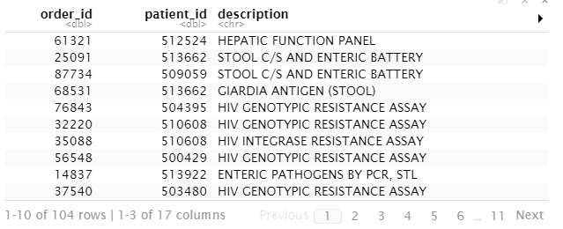
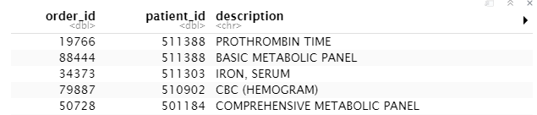
filter(orders, order_id > 100000)
filter(orders, lab_status_c_descr == "Final result")
filter(orders, !is.na(reason_for_canc_c_descr))

Slide 40
Common mistakes
1. Using = instead of ==
filter(orders, proc_code = "BMP")
filter(orders, proc_code == "BMP")
2. Forgetting quotes
filter(orders, proc_code == COMP)
filter(orders, proc_code == "COMP")

Slide 41
Common mistakes
3. Capitalization matters
Filter(Orders, proc_code == "BMP")
filter(orders, proc_code == "BMP")
4. Spelling
fitler(orders, proc_code == "COMP")
filter(orders, proc_code == "COMP")

Slide 42
filter()
Extract rows that meet multiple logical criteria.
filter(orders, patient_id == 508061, description=="T4, FREE")
orders
order_id | patient_id | description | proc_code
19766 | 511388 | PROTHROMBIN TIME | PRO
88444 | 511388 | BASIC METABOLIC PANEL | BMP
40477 | 508061 | THYROID STIMULATING HORMONE | TSH
97641 | 508061 | T4, FREE | T4FR
order_id | patient_id | description | proc_code
97641 | 508061 | T4, FREE | T4FR
Notes:
Combining logical operators
You can combine tests by putting a comma in between tests and filter will combine the two statements as if there is an and statement
between them, condition A and condition B.

Slide 43
Boolean operators
?base::Logic
a & b | and
a | b | or
!a | not
a %in% c(a, b) | one of (in)
Notes:
You have a variety of operators with which to join two or more logic statements.
You could formally tell filter to join the two logical tests using the ‘&’ symbol. You can include an ‘or’ condition using the pipe character |, e.g. condition A | condition B.
Both in dplyr and throughout R the exclamation point ! is used as a negation. Finally, dplyr supports a convenience function in which you can test if the values in a column match any of a vector of values (equivalent to, say, patient_id equals x, y, or z). This is implemented with the %in% function. For example one could write filter(orders, proc_code %in% c(“BMP”,”COMP”)) to match orders for either a BMP or COMP.

Slide 44
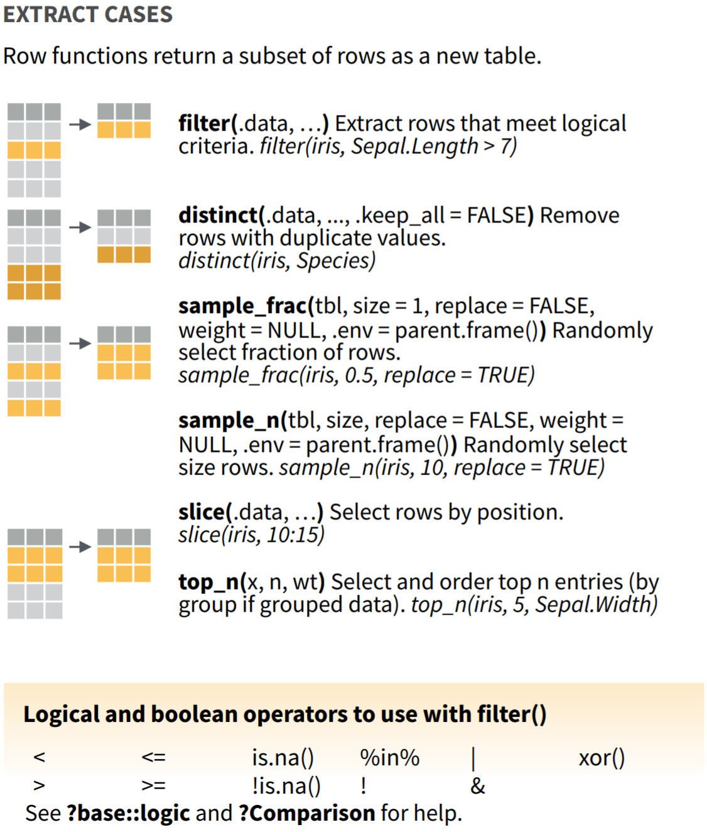
filter() variants
Notes:
I’ve only listed for you a selection of the available ways you can use helpers with select() to pull out the columns you need for your analysis. For a more complete list, see the select() section on the dplyr cheatsheet,

Slide 45
Your Turn 4
Write 3 commands that use Boolean operators and filter() to return rows that contain:
Orders for patient number 510909 with proc_code TSH
Orders for any of one of the following departments: OB GYN CLINIC, GERIATRIC CLINIC, or PEDIATRIC CLINICS
Orders for tests that were canceled and originally chosen from a preference list (HINT: These are coded in the pref_list_type column)

Slide 46
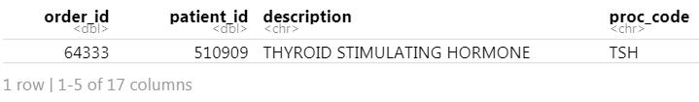
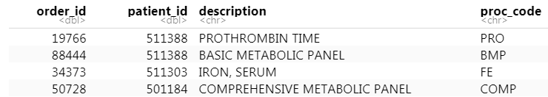
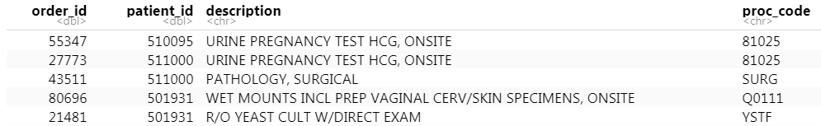
filter(orders, proc_code == "TSH", patient_id == "510909")
filter(orders, pref_list_type == "Clinic Preference List" |
pref_list_type == "Provider Preference List",
!is.na(reason_for_canc_c))
filter(orders, department %in% c("OB GYN CLINIC","GERIATRIC CLINIC","PEDIATRIC CLINICS"))

Slide 47
arrange()
Notes:
Often when exploring your data you’ll be interested in organizing the rows according to values in a specific column or columns. That’s what arrange() does. It let’s you focus on the most important parts of your data by rearranging and organizing it.

Slide 48
arrange()
Order rows from smallest to largest values
arrange(data,... )
data frame to transform
name(s) of columns to arrange by
Notes:
As we’ve seen, dplyr functions all have similar syntax and arrange is no exception. The data frame is your first argument. After that you can list one or more columns, each separated by a column, to arrange the data frame by.

Slide 49
arrange()
Order rows from smallest to largest values
arrange(orders, result_time)
order_id | patient_id | description | result_time
19766 | 511388 | PROTHROMBIN TIME | 2017-09-20
88444 | 511388 | BASIC METABOLIC PANEL | 2017-09-01
40477 | 508061 | THYROID STIMULATING HORMONE | 2017-09-28
97641 | 508061 | T4, FREE | 2017-09-04
order_id | patient_id | description | result_time
88444 | 511388 | BASIC METABOLIC PANEL | 2017-09-01
97641 | 508061 | T4, FREE | 2017-09-04
19766 | 511388 | PROTHROMBIN TIME | 2017-09-20
40477 | 508061 | THYROID STIMULATING HORMONE | 2017-09-28
Notes:
In this example we are arranging orders data frame by the result_time, which allows us to review the orders in the order in which the results were generated, rather than the seemingly haphazard way they have been exported in this data set.

Slide 50
arrange()
Order rows from smallest to largest values
arrange(orders, desc(result_time))
order_id | patient_id | description | result_time
19766 | 511388 | PROTHROMBIN TIME | 2017-09-20
88444 | 511388 | BASIC METABOLIC PANEL | 2017-09-01
40477 | 508061 | THYROID STIMULATING HORMONE | 2017-09-28
97641 | 508061 | T4, FREE | 2017-09-04
order_id | patient_id | description | result_time
40477 | 508061 | THYROID STIMULATING HORMONE | 2017-09-28
19766 | 511388 | PROTHROMBIN TIME | 2017-09-20
97641 | 508061 | T4, FREE | 2017-09-04
88444 | 511388 | BASIC METABOLIC PANEL | 2017-09-01
Notes:
Sometimes we’ll be interested in viewing the data in reverse chronological order. By default arrange will order the rows from smallest to largest, from a to z, or from earliest date to latest. We can reverse this by wrapping our column of interest in the desc() function.

Slide 51
arrange()
Order rows from smallest to largest values
arrange(orders, patient_id, result_time)
order_id | patient_id | description | result_time
19766 | 511388 | PROTHROMBIN TIME | 2017-09-20
88444 | 511388 | BASIC METABOLIC PANEL | 2017-09-01
40477 | 508061 | THYROID STIMULATING HORMONE | 2017-09-28
97641 | 508061 | T4, FREE | 2017-09-04
order_id | patient_id | description | result_time
97641 | 508061 | T4, FREE | 2017-09-04
40477 | 508061 | THYROID STIMULATING HORMONE | 2017-09-28
88444 | 511388 | BASIC METABOLIC PANEL | 2017-09-01
19766 | 511388 | PROTHROMBIN TIME | 2017-09-20
Notes:
Let’s say we want to arrange the orders by patient first, and then by date. When listing only one column, ties will be arranged on the basis of the order they appeared in the original data frame. However if two columns are listed then the second column will be used as a tie-breaker. Additional columns can be added to further order tied rows.

Slide 52
Your Turn 5
Arrange orders by order_status_c_descr. What order statuses appear in the top rows of the data frame?
Add order_class_c_descr as a second (tie breaking) column to arrange on, but order it in reverse alphabetical order.
CHALLENGE:
Explore what type of order class appears at the top of the data frame. To what type of lab test does this order class seem to relate to?

Slide 53
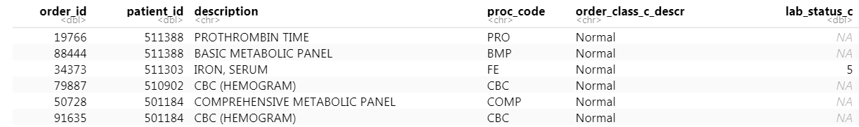
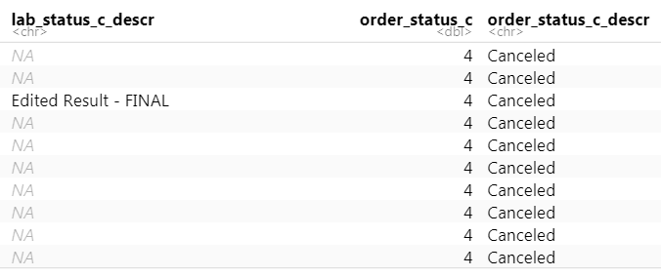
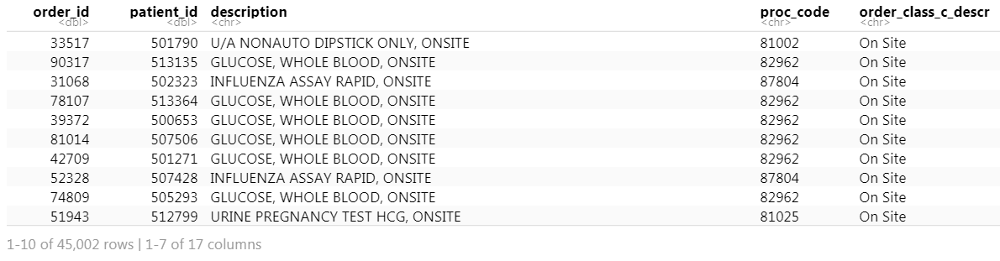
arrange(orders, order_status_c_descr)
arrange(orders, order_status_c_descr,
desc(order_class_c_descr))

Slide 54
%>%
Notes:
Now that we have a decent toolkit of functions with which to manipulate our data we should take a step back and talk about the data analysis process.
In any real data manipulation task you're probably not just going to use one verb but you're going to string multiple verbs together into a series of steps that overall accomplish a goal.

Slide 55
Data Analysis Steps
VITD <- filter(orders, description == "1,25 DIHYDROXY VITAMIN D")
Who is ordering the wrong kind of vitamin D?
VITD <- select(VITD, department, ordering_route, pref_list_type)
VITD <- arrange(VITD, department)
1. Filter orders to 1, 25 Vitamin D
2. Select the relevant columns that contain ordering information
3. Arrange those columns by department
Notes:
For instance, in the context of the orders data set, one may investigate the ordering of tests that are not recommended for routine use, such as 1,25 dihydroxy vitamin D. The 25-hydroxy vitamin D level is the preferred test for screening for vitamin D deficiency. The 1,25 dihydroxy vitamin D level is used in rare and unique clinical situations, however it is often ordered by unwitting providers. To determine who is ordering the non-recommended test, one could start by filtering to the relevant test, select the columns that were necessary, and then maybe arrange the rows in a useful way.
It’s easy to see that this analysis requires a lot of typing, and has a lot of redundancy in that we sequentially update the new data frame 125VITD as well progress through the analysis.

Slide 56
Data Analysis Steps
VITD <- arrange(
select(
filter(
orders,
description == "1,25 DIHYDROXY VITAMIN D"
),
department,
ordering_route,
pref_list_type
),
pref_list_type
)
Notes:
An alternative would be to nest these functions one within the other. When nesting functions the innermost function is evaluated first followed sequentially by the next inner ones. We can see that we have made the code much more efficient but at a significant price. The code is really complicated to look at, it’s not at all obvious what the code is trying to accomplish. The arguments for functions are spatially far away from the names of the functions themselves. For instance, the argument for arrange() is pref_list_type, but that’s not easy to see in this snippet of code. What would be helpful when performing fairly typical analyses such as these would be a syntax that was both efficient as well as human readable.

Slide 57
The Pipe Operator %>%
orders
%>%
filter(____, patient_id == 508061)
Passes result on left into first argument of function on right.
filter(orders, patient_id == 508061)
orders %>% filter(patient_id == 508061)
Notes:
This is exactly what the pipe operator does. The pipe operator does something very simple but at the same time incredible useful. It takes the product of whatever is on the left and puts it into the function on the right. So for instance, the two lines of code in the gray box do exactly the same thing. One advantage that you may notice is that the second snippet of code is immediately far more expressive in human language. You could read the statement as “Take the orders data frame, and then filter the patient_id column to rows containing 508061.”

Slide 58
Data Analysis Steps
125VITD <- arrange(
select(
filter(
orders,
description == "1,25 DIHYDROXY VITAMIN D"
),
department,
ordering_route,
pref_list_type
),
pref_list_type
)
Notes:
The advantage of this is even more clear when performing a more complicated analysis such as this one. You can take this code, which is essentially illegible, and transform it into the code on the following slide.

Slide 59
Data Analysis Steps
VITD <- orders %>%
filter(description == "1,25 DIHYDROXY VITAMIN D") %>%
select(department, ordering_route, pref_list_type) %>%
arrange(pref_list_type)
Notes:
The code here is far more succinct. It self describes what it does since it’s written in a sequential, essentially human readable format. This makes it easier to construct code as you’re performing analysis since this is how we think about an analytical pipeline. It also makes it much easier to understand when you’re coming back to it after having put it aside for several months. The pipe operator allows us to form chains of complicated data transformation operations that are made up of very simple, self-contained, building blocks. The goal is to make something complex by joining together many simple things that are easy to understand in isolation.

Slide 60
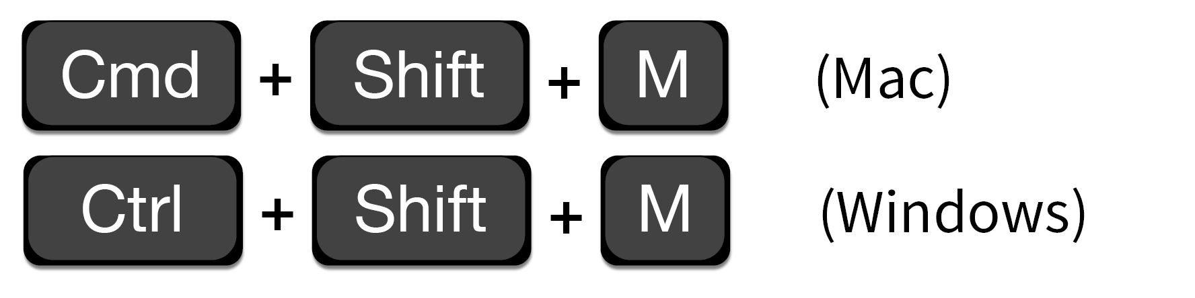
Shortcut to type %>%

Slide 61
Your Turn 6
Use %>% to write a sequence of three functions that:
1. Filters to orders coming from the "BEHAVIORAL HEALTH CLINIC"
2. Selects the description, ordering_route, and pref_list_type
3. Arrange the dataset by the description and ordering_route columns
Using <-, assign the result to a new variable.
4. CHALLENGE- Use your mouse to select the name of the new data frame from the list of data sets in the upper-right pane of Rstudio. Do you notice any ordering patterns?

Slide 62
orders %>%
filter(department =='BEHAVIORAL HEALTH CLINIC') %>%
select(description,pref_list_type, ordering_route) %>%
arrange(description,ordering_route)

Slide 63
Isolating data
Extract variables with select()
Extract rows with filter()
Arrange rows, with arrange().
Notes:
So far we’ve covered functions whose primary job is to reshape your data but don’t fundamentally tell you something about what’s inside of it.

Slide 64
Deriving Data

Slide 65

What are the top 3 tests ordered on weekends?
Notes:
If you’re interested in orders for basic metabolic panels from September, then you can do that. However if you want to learn something from your data you have to summarize it. For instance, what if you want to know what your lab’s top three ordered tests are on weekends? You have the right data to answer that question, but we need to derive the answer from it.

Slide 66
Breaking down the analytical question
Day of the week for each order
Count of each test one weekend
Ranking of tests by count
Notes:
To answer a question like the one we posed on the previous slide, it can help to break it down into the steps that we need to take to get to the finish line. In this case, we’re going to have to figure out which weekday the tests were ordered. We’ll probably be working with the order_time column for that. Then we’ll have to count the number of orders per test on the weekend. Finally we’ll have to put the in rank order.

Slide 67
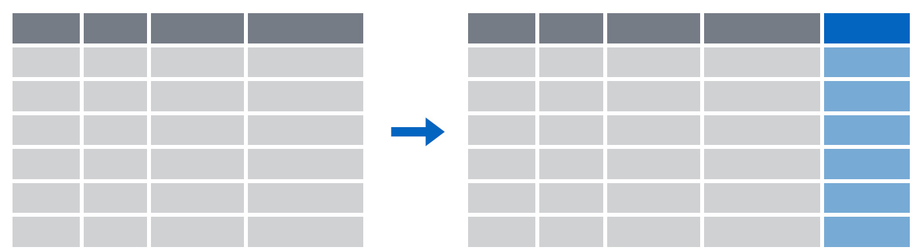
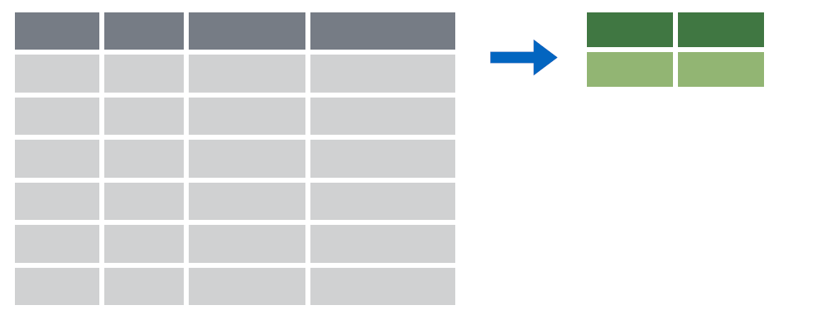
Deriving data
Make new variables with mutate()
Make summaries of data with summarize()
Notes:
To answer questions like these we’re going to need a new set of functions whose job is to derive new data from our original data frame. The two work-horse functions in dplyr to accomplish these types of tasks are mutate() and summarize().

Slide 68
mutate()
Notes:
We’ll begin with the mutate() function.

Slide 69
mutate()
Creating new columns
Notes:
The goal of mutate() is very simple. You’ll feed it your original data frame and it’s going to kick out the same data frame with one or more new columns tacked onto the end based on calculations that you specify.

Slide 70
mutate()
Creating new columns
orders %>%
mutate(new_column = calculation)
function whose results will populate columns
name for new column
equals
Notes:
The syntax is going to look familiar to the functions we saw earlier but with a small change. As before, the first argument is the original data frame, which gets piped into mutate. Then you specify the name of the new column you want to add, you type of an equals sign, and then you write a calculation. This calculation will be run on each row of your data frame and the result will populate each row of the new column.

Slide 71
mutate()
calculation can involve another column in the data frame
Creating new columns
orders %>%
mutate(coded_order_id = order_id/2)
order_id | patient_id
19766 | 511388
88444 | 511388
40477 | 508061
97641 | 508061
order_id | patient_id
19766 | 511388
88444 | 511388
40477 | 508061
97641 | 508061
coded_order_id
9883
44222
20238
48820
Notes:
Let’s look at an example. Say we wanted to share our data set with a research collaborator. What we could do is create a new column, called for instance “coded_order_id” and set that equal to half the numeric value contained in order_id. In this situation mutate() would perform that calculation on each row and place the result in a new column at the right most part of our data frame. Note how in this example we essentially treat order_id like it’s a variable. This is a feature of mutate(). We can refer to values in other columns in the same data frame simply by referring to their name.
Note: I am not at all suggesting that this is appropriate practice when encrypting your data for sharing with a colleague.

Slide 72
Your Turn 7
The weekdays() function will return the weekday for any date.
Use the weekdays() function with mutate() to make a new column which contains the day of the week that each order was placed
Then select this column and the order_time
column

Slide 73
orders %>%
mutate(dayofweek = weekdays(order_time)) %>%
select(dayofweek, order_time)

Slide 74
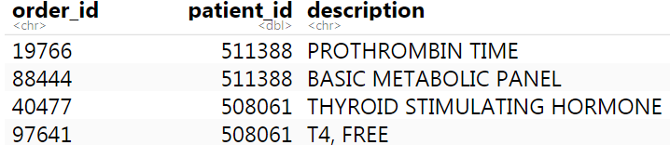
mutate()
Function to "coerce" one type of data into another type of data
Replacing columns
orders %>%
mutate(order_id = as.character(order_id))

Slide 75
data types in R
Type of Data | Function | Result of Function
Character | as.character(1) | "1"
Numeric | as.numeric("123") | 123
Logical | as.logical(1) | TRUE
Date | as.Date("05-06-2019") | NA
Notes:
alternative

Slide 76
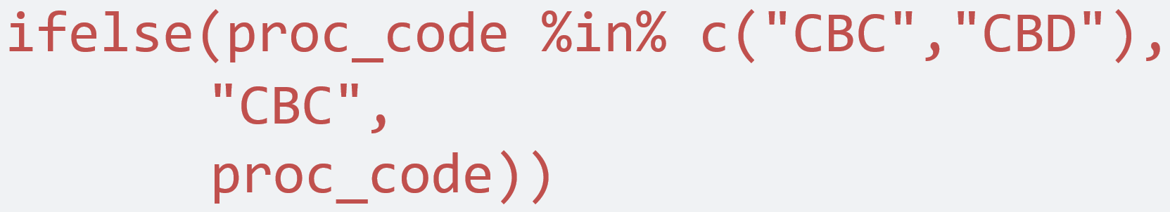
mutate()
Conditionally replace values in a column
orders %>%
mutate(proc_code =
ifelse(proc_code %in% c("CBC","CBD"), "CBC",
proc_code))
logical statement
value if true
value if false

Slide 77
Your Turn: Final Challenge
Conditionally replace values in pref_list_type:
The pref_list_type column has values of either:
"Clinic Preference List", "Provider Preference List", "None"
Conditionally replace these with :
"clinic", "provider", and NA, respectively.

Slide 78
orders %>%
mutate(pref_list_type = ifelse(pref_list_type=="None",
NA,
ifelse(pref_list_type=="Clinic Preference List", "clinic",pref_list_type)))

